Slide 1
Preserving Your Secret Sauce: The Steve Trautman Co. 3-step Knowledge Transfer Process
Presenter: Please view the slide notes for guidance on slides
Notes:
The purpose of these slides is to help present the 3-step Knowledge Transfer Solution to executives and colleagues internally within your organization. Users can take any or all of the slides in this desk to help outline the business problem(s), the solution using knowledge transfer, and the outcomes of working with us. If you’d like any more support or help in creating a presentation, we’d love to help! Just contact Sonja at 206-547-1775 or sonja@stevetrautman.com

Slide 2
What is Knowledge Transfer?
Knowledge transfer is more than just on-the-job training. It is also replicating the expertise, wisdom and tacit knowledge of critical professionals into the heads and hands of their co-workers.
In order to transfer knowledge you need to know:
What are the talent/skill risks?
What is the priority?
Who knows?
Who needs to know?
When is the risk going to be reduced?
Notes:
The purpose of this slide is to provide a basic definition so that we can agree what knowledge transfer really is. Then we quickly outline 5 questions that drive successful knowledge transfer.

Slide 3
WHAT keeps you AWAKE at night?
Select all the challenges that apply to you:
Onboarding new employees faster
Kicking off new projects and adding resources to existing projects
Departing/retiring workers with critical and unique knowledge (boomers and gen x or gen y)
Cross-training to foster innovation, consistency, flexibility and culture
Speeding recovery after reorganizations, mergers and acquisitions
Deploying and managing contractors to a standard (outsourcing/insourcing)
Defining roles and expectations within and between teams
Notes:
This is a list of common problems facing organizations that we work with. Add new items or prioritize as needed.

Slide 4
3-STEP Knowledge Transfer Solution
Assess Risk
Do we have enough bench strength for the critical areas of expertise (“knowledge silos”) to deliver on our strategy 12-36 months from now?
2. Create a Skill Development Plan
List the specific skills, wisdom and tacit knowledge that must be transferred to measurably reduce risk.
3. Training
Make it easy for experts to transfer knowledge on the job, and for apprentices to take responsibility for their own development.
Notes:
This slide broadly outlines the 3 steps that make up our Knowledge Transfer Solution. Together these 3 form the “soup to nuts” platform for successful knowledge transfer within an organization. Step 1 is our Knowledge Silo Matrix (KSM), Step 2 is our Skill Development Plan (SDP) and Step 3 is our Knowledge Transfer Workshop (KTW). You will see these in their branded format on the next slide. If you’d like to see Steve talk through this slide, please view at https://www.youtube.com/watch?v=1xj1iVhu308

Slide 5
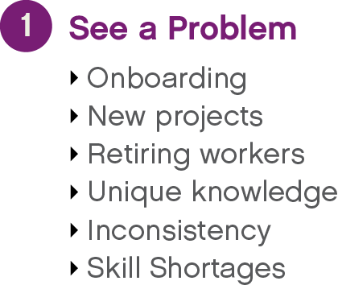
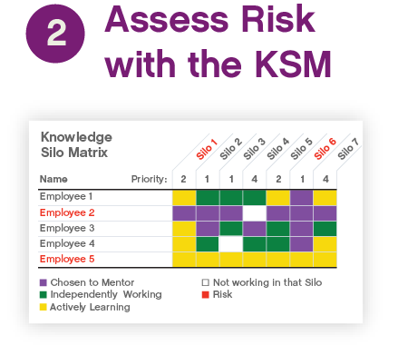
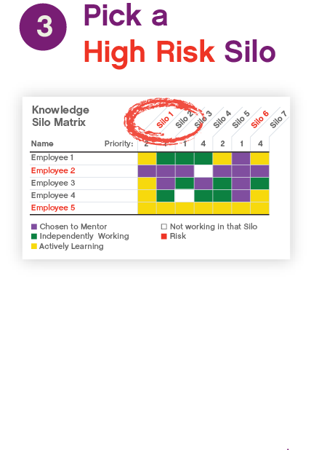
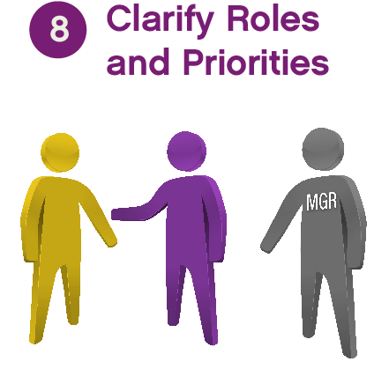
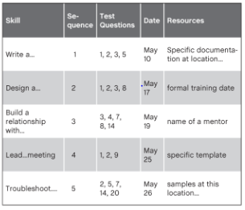
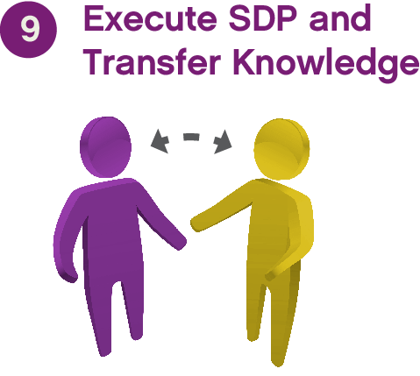
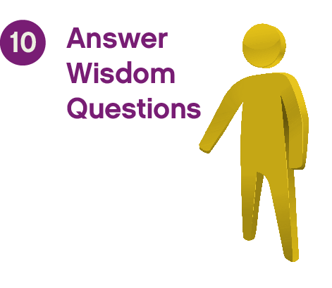
Step 1:
Step 2:
Step 3:
Notes:
This is an animated slide that progresses step-by-step through the full solution, illustrating how the process works with experts and apprentices. As we mentioned in the prior slide, the prior slide might be a little repetitive, with this slide showing the full “map.” To hear Steve talking through this slide, go to: https://www.youtube.com/watch?v=tWyMU90x6o4 and here is a transcript of that video: “Our 3-step Knowledge Transfer Solution starts with the Knowledge Silo Matrix (click Step 1: KSM), which (click to purple circle 1) starts with the problem…the risk that we perceive, such as onboarding, or new employees, or somebody getting ready to retire. (click to purple 2) We conduct a Knowledge Silo Matrix to see where the expertise lies, (click to 3), we pick a silo to prioritize, (click to 4) and we pick an expert who will represent that silo and become the person we want to replicate. (Click to Step 2: SDP) Then we build a plan (click 5), then we interview the expert and write a skill development plan, (click 6) and then we pick an apprentice to learn the knowledge silo – this person is marked yellow, (click 7) then we customize the plan for that individual , and then (click 8) we set up a conversation to clarify roles and priorities, (such as) ‘How does this mentoring function? How does this knowledge transfer function fit with your daily work?’ And then finally (click Step 3: KTW), we train them (click 9) so that they learn how to execute on the Skill Development Plan within the context of their day job, and we prove the apprentices learn by (click 10), having him or her pass the ‘test,’ and then they can go from yellow to green. (click 11) They go from ‘I don’t know’ to ‘I know.’ And this is a machine (process) that is built that you can plug anybody into. You can plug in a brand-new hire, you can plug in a ten-year veteran who (for example) came from another plant, you can plug in somebody who is 20 years at this plant but needs to cross train…basically whoever you have as your apprentice. You can plug in a vendor that doesn’t know now to play nice with your site (eg. work consistently to the standards of your org) – whoever it is you need to teach can be plugged into this system. Sometimes this process takes a year, and sometimes it takes a day. All of the pieces are in place to take this on.

Slide 6
Who is The Steve Trautman Co.?
The Steve Trautman Co. are experts in knowledge transfer.
They provide a knowledge transfer framework that supports proactive, methodical, measurable on-the-job training.
They offer a variety of services from free tools to a comprehensive knowledge transfer program. As part of the comprehensive program they certify clients on the tools and skills to run the program internally.
The company, now in its 19th year, works globally with high-profile clients in industries such as high tech, manufacturing, finance, energy, and communications.
Notes:
This slide can be used to answer the question, “who are these people who claim they can help?” Additional info: Steve developed his knowledge transfer expertise in the early 1990s when he worked at Microsoft, and his knowledge transfer solution is now used by companies ranging from Boeing to Nike, Kraft to Zynga. He has written two books, “Teach What You Know: A Practical Leader’s Guide to Knowledge Transfer through Peer Mentoring” and “The Executive Guide to High Impact Talent Management”

Slide 7
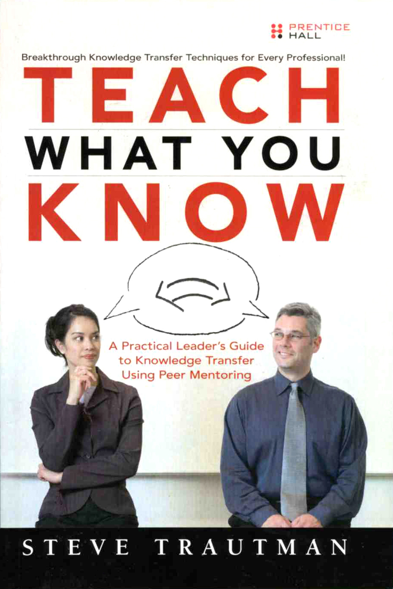
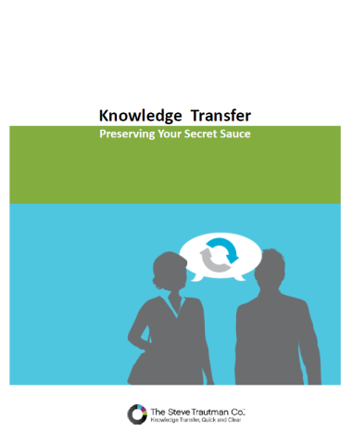
Questions?
LEARN MORE!
Download the White Paper
Knowledge Transfer: Preserving Your Secret Sauce
www.stevetrautman.com
Notes:
Steve has written two books, Teach What You Know: a Practical Leader’s Guide to Knowledge Transfer Using Peer Mentoring (Prentice Hall, 2006) and The Executive Guide to High-Impact Talent Management (McGraw Hill, 2011; with coauthor Dave DeLong). His terminology and innovative concepts in the field of knowledge transfer have been adopted at the CEO level of many Fortune 500 organizations.
Please feel free to ask for more presentation materials that you wish to use; we also have videos on our YouTube channel, SteveTrautmanCo. Contact Sonja at (206)-547-1775 or sonja@stevetrautman.com

